Slide 1
IMAGE CARTOONIFIER
Miniproject by:
Karishma Bairi (A-15)
Shweta Kaware (A-06)
Abhishek Eitkar (A-14)
Under guidance of Prof. Seema Biday

Slide 2
Table of Contents
Abstract
Introduction
Literature Survey
Methodology
Result
Conclusion
References

Slide 3
Abstract
In the field of the research processing of an image consisting of identifying an object in an image, identify the dimensions, no of objects, changing the images to blur effect and such effects are highly appreciated in this modern era of media and communication.
There are multiple properties in the Image Processing.
Each of the property estimates the image to be produced more with essence and sharper image.
Each Image is examined to various grid.
Each picture element together is viewed as a 2-D Matrix with each of the cell store different pixel values corresponding to each of the picture element.

Slide 4
INTRODUCTION
The image processing plays a major role in all computers related applications.
The image processing appears in many real-life applications, e.g., home security, banking system, education sector, defense system, Railway, and so on.
Cartooning of an image offers a rapid contribution to human interest. Each confined methodology helps in filtering the picture element that forms to an image. There are various factors that enables to produce the essence of an image. The concerns ae contrasting and appropriate color mixing, matching between any two pixels connecting two cells, accurate placing of objects together combined to form image features.
The amount of research in the image processing has helped to acquire early detection of tumors. There plays a vital role in the field of image processing and in the field of Biology. This research bound to save livelihood as early detection can be identified and effective treatment can be started off. These extended concepts have enabled to build better security systems which ensure safety. The security/surveillance systems have managed to build systems depending on the image processing algorithms.
The basic concept in this algorithm involves the technique of converting the RGB colour image to an accurate, cartooned image without multiple filtrations or blurred image without proper facilitation of edge detection. This user interface allows to apply the animation effects. This naturally provides an artistic effect and comics as well with wide range of pictures.

Slide 5
LITERATURE SURVEY
Year | Author Name | Paper Name
2020 | Mohapatra H.; Rath A. K. | A. K. Fundamentals of software engineering: Designed to provide an insight into thesoftware engineering concepts
2019 | Kumar R.; Dey A | A study of neutrosophic shortest path problem. In Neutrosophic Graph Theory and Algorithms
2018 | Kumar R.; Edaltpanh S. A.; Jha S.; Broumi S.; Dey A. | Neutrosophic shortest path problem. Neutrosophic Sets and Systems
2017 | Nirgude V.; Mahapatra H.; Shivarkar S | Face recognition system using principal component analysis & linear discriminant analysis method simultaneously with 3d morphable model and neural network BPNN method. Global Journal of Advanced Engineering Technologies and Sciences
2015 | BM M.; Mohapatra H | Human centric software engineering. International Journal of Innovations & Advancement in Computer Science

Slide 6
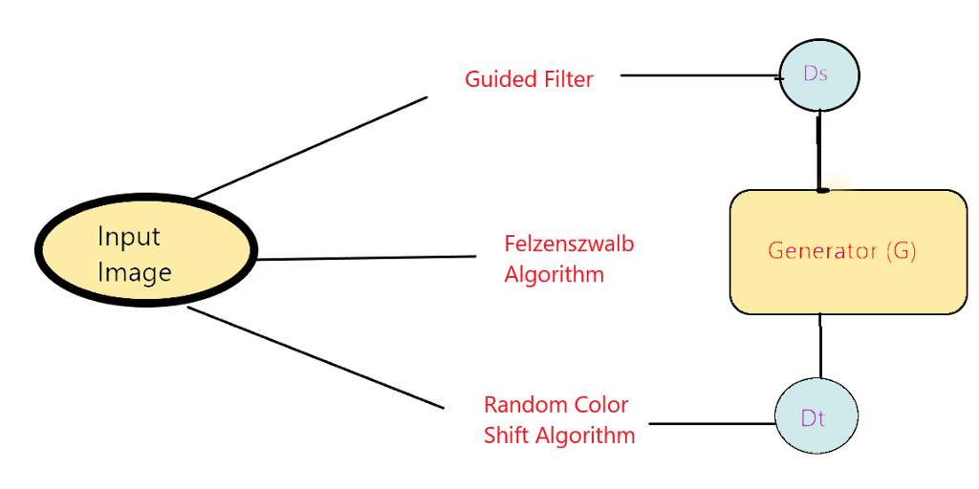
METHODOLOGY

Slide 7
The model decomposes images into three different cartoon representations, which further counsel the network optimization to generate cartoonized images. Surface Representation: It helps to extract smooth surfaces of the image that contains a weighted low-frequency component where the color composition and surface texture are retained along with edges, textures, and details. Structure Representation: It helps to derive global structural information and sparse color blocks, once done we implement adaptive coloring algorithms like the Felzenswalb algorithm to develop structural representation that can help us to generate sparse visual effects for celluloid styled cartoon process. Textured Representation: It helps us to retain painted details and edges. The three-dimensional image is converted to single-channel intensity map that helps to retain pixel intensity compromising color and luminance, it follows the approach of manual artist that first draw a line sketch with contours and then apply colors to it.

Slide 8
Approach: Preprocessing Along with the proposed three-step approach, preprocessing is an important part of our model. It helps to smoothen the image, filter the features, converting it to sketches, and translating the output from a domain to another. After implementing these related work we can be sure that the output generated by our model will give us the best output that retains the highest quality features. Preprocessing: Along with the proposed three-step approach, preprocessing is an important part of our model. It helps to smoothen the image, filter the features, converting it to sketches, and translating the output from a domain to another. After implementing these related work we can be sure that the output generated by our model will give us the best output that retains the highest quality features. Super-pixel and Structure Extraction: This method is used to divide the image into regions and defining a predicate for measuring the boundary between two regions. Based on the predicate segmentation, an algorithm is developed whose decision is based on a greedy technique but still helps to satisfy global properties. After identification of contours, we implement Gradient Ascent to initialize the image with rough clusters and iteratively amend the clusters until convergence. Advancing our process, to develop a cartoon-like segmentation method we use the Felzenszwalb algorithm that helps us to seize global content information and produce practically usable results for celluloid style cartoon workflows. Image Smoothening: To extract smooth and cartoon resembling surfaces from images, Guided filters are used. A guided filter is an advanced version of Bilateral filters with better near the edge behavior. The goal is simply removing/significantly decreasing the noise and obtaining useful image structures. The filtering output of the guided filter is an optimal linear transform of an input image. Following the approach of Bilateral filters it retains smoothing property and in addition, is free from gradient reversal artifacts.

Slide 9
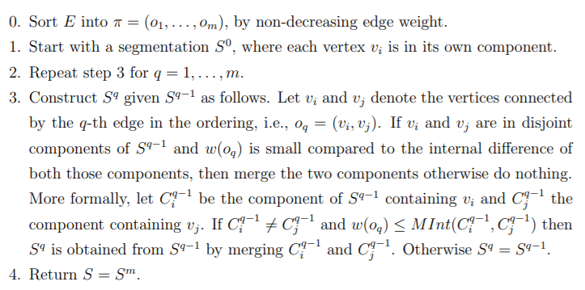
Felzenszwalb Algorithm: Given an input graph G = (V, E), with n vertices and m edges. The output is a segmentation of V into components S = (C1, . . . , Cr). The algorithm is as follows:

Slide 10
The algorithm follows a bottom-up procedure. Given G=(V,E) and |V|=n, |E|=m. Where |V| is the number of vertices(pixels) and |E| is the number of edges. Edges are sorted by weight in ascending order, labeled as e₁,e₂,…,e_{m}. Initially, each pixel stays in its own component, so we start with n components. Repeat for k=1,…,m: The segmentation snapshot at step k is denoted as Sk. We take the k-th edge in the order, ek=(v_{i} , v_{j}). If v_{i} and v_{j} belong to the same component, do nothing and thus S^{k}=S^{k−1}. If v_{i} and v_{j} belong to two different components C_{i}^{k−1} and C_{j}^{k−1} as in the segmentation of S^{k−1} we want to merge them into one if w(v_{i},v_{j}) ≤ MInt(C_{i}^{k−1},C_{j}^{k−1}); otherwise do nothing.

Slide 11
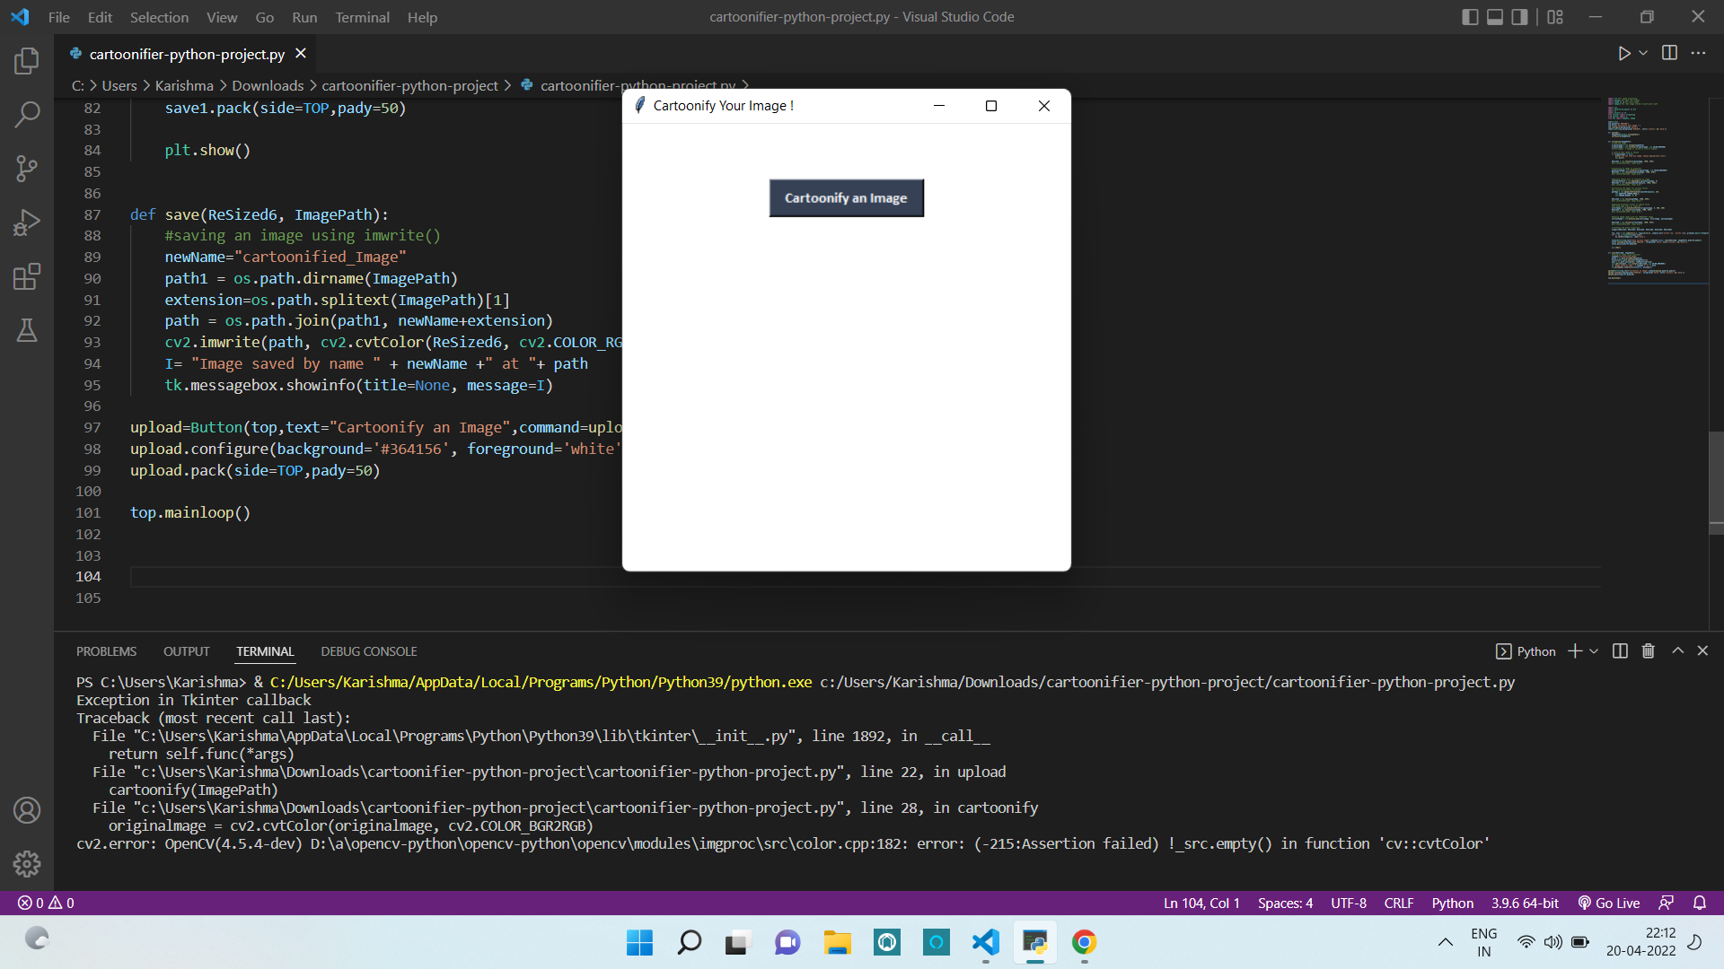
RESULT

Slide 12
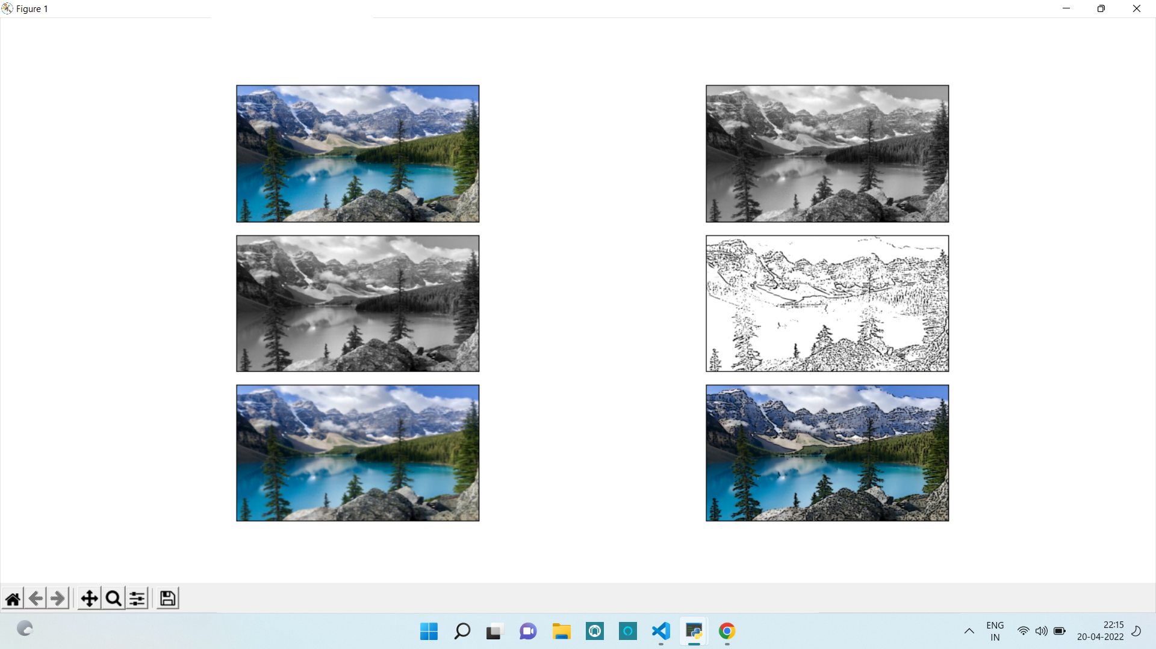

Slide 13
CONCLUSION
First of all, the basic tools to handle the titled problems of the thesis are incorporated.
It includes origin and history of image processing, different types of uncertain environment, existing methods for cartoon imaging.
Amid the previous three decades, the topic of image processing has gained vital name and recognition among researchers because of their frequent look in varied and widespread applications within the field of various branches of science and engineering.
As an example, image processing is helpful to issues in signature recognition, digital video processing, Remote Sensing and finance.
Conclusion and Future Directions. Firstly, we use high-resolution camera to take picture of the internal structure of the wire. Secondly, we use OpenCV image processing functions to implement image pre-processing. Thirdly we use morphological opening and closing operations to segment image because of their blur image edges.
The main attraction of the paper is to solve different types of images having one object, two object and three object which can’t be solved by any of the exiting methods but can be solved by our proposed method.

Slide 14
REFERENCES
https://www.academia.edu/44964756/Cartooning_an_Image_Using_Opencv_and_Python
https://www.researchgate.net/publication/333686497_Application_of_Cartoon_Like_Effects_to_Actual_Images
https://www.researchgate.net/publication/264132632_A_Study_on_the_Cartoon_Style_in_Image_Contents
https://www.irjet.net/archives/V7/i1/IRJET-V7I1376.pdf
https://doi.org/10.46501/IJMTST0705010

Slide 15
THANK YOU !

